Slide 1
Optical Multiplexing & Filters
optical communication networks
Sanjeet Krishna – 60002160050
Atulya Kumar – 60002160052
Yash Maru - 60002160058
Vidhi Meghani – 60002160059

Slide 2
Multiplexing & Demultiplexing
Multiplexing
What are Multiplexers?
Multiplexers are hardware components that combine multiple analog or digital input signals into a single line of transmission.
And at the receiver’s end, the multiplexers are known as de-multiplexers – performing reverse function of multiplexers.
Multiplexing is therefore the process of combining two or more input signals into a single transmission.
At receiver’s end, the combined signals are separated into distinct separate signal.
Multiplexing enhances efficiency use of bandwidth.

Slide 3
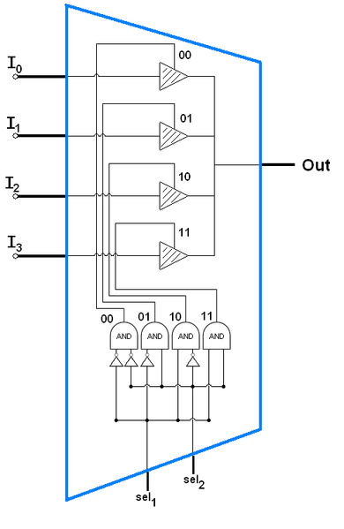
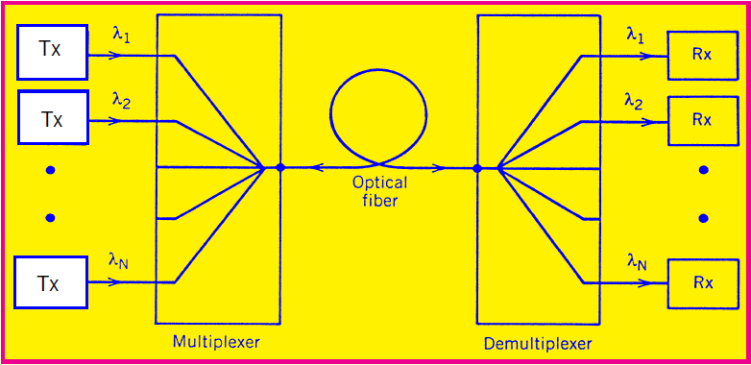
Multiplexer

Slide 4
Optical Multiplexing
Optical multiplexer and de-multiplexer are basically passive optical filter systems, which are arranged to process specific wavelengths in and out of the transport system (usually optical fiber).
Process of filtering the wavelengths can be performed using:
Prisms
Thin film filter
Dichroic filters or interference filters
The filtering materials are used to selectively reflect a single wavelength of light but pass all others transparently.
Each filter is tuned for a specific wavelength

Slide 5
Advantages
High data rate and throughput
Data rates possible in optical transmission are usually in Gbps on each wavelength.
Combination of different wavelengths means more throughput in one single communication systems.
Low attenuation
Optical communication has low attenuation compare to other transport system.
Less propagation delay
More services offered
Increase return on investment (ROI)
Low Bit Error Rate (BER)

Slide 6
Optical Multiplexing Techniques
Optical Time Division Multiplexing (OTDM)
Separating wavelengths in time
Wavelength division multiplexing (WDM)
Each channel is assigned a unique carrier frequency
Channel spacing of about 50GHz
Dense Wavelength Division Multiplexing (DWDM)
Uses a much narrower channel spacing, therefore, many more wavelengths are supported.

Slide 7
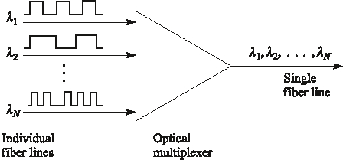
Wavelength Division Multiplexing
Each light source emits different wavelength.
Each wavelength is like a separate channel (fiber)
Elements of WDM : 1. Optical Line Terminals 2. Optical Add/Drop Multiplexers
Notes:
6

Slide 8
Advantages of WDM
Transparency: Each optical channel can carry any transmission format (different asynchronous bit rates, analog or digital)
Scalability: Can buy and install equipment for additional demand as needed.
Survivability: Architecture detects failure and in such cases the light is routed through different paths.
Wavelength reuse and conversion: Same wavelength can be used until the path overlaps. Whenever there is overlapping of light paths then a wavelength conversion is required.

Slide 9
OADM – Optical Add/Drop Multiplexers
Optical multiplexers are components specifically designed for wavelength division multiplexing (WDM) systems.
The function of an optical drop-add multiplexer is to selectively remove a wavelength and add the same wavelength in the fiber.
The commonly used OADM architectures are:
Parallel
Serial
The two types of OADM’s are:
Fixed
Reconfigurable

Slide 10
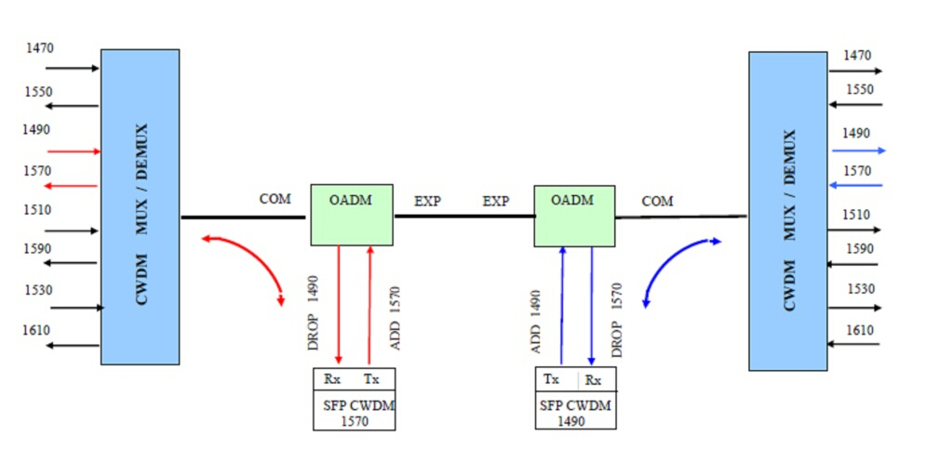
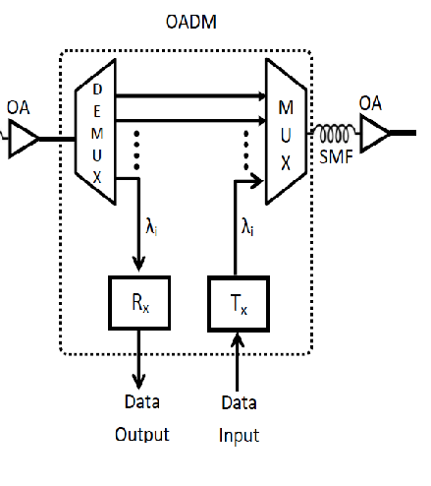
Architectures
Parallel
Initially all incoming channels are multiplexed to generate separate output wavelength (λ1, λ2 ….)
Some wavelengths are dropped at this stage and other wavelengths are passed forward to the multiplexer.
At the multiplexer some other wavelength channels are also added (λ’1, λ’2 ….)
Serial
This architecture can drop or add a single channel at a time.
If more than one channel have to be added or dropped at a time, then a number of such architectures are connected in series.

Slide 11
Types
Fixed OADM or FOADM
In FOADM, the wavelength has been selected and remains the same until human intervention changes it.
It uses a filter to select a dropping wavelength
It uses multiplexer to add a new channel at the same wavelength
Reconfigurable OADM or ROADM
It is a dynamic type OADM, which has the ability to remotely switch traffic from a WDM system at the wavelength layer
In reconfigurable selectable wavelength OADM, the wavelengths between the optical demultiplexer/multiplexer may be dynamically directed from the outputs of the demultiplexer to any of the inputs of the multiplexer

Slide 12
DWDM
Need:
Attenuation and dispersion, limit the practical speed and the distance of communication
EDFA is used to tackle the attenuation problem.
But due to Bandwidth effect, there is always a trade-off between transmission distance and bandwidth.
DWDM is used to increase bandwidth without the use of repeaters.

Slide 13
DWDM Working
The DWDM takes an optical signal input and divides it into different wavelength.
The laser source transmits different wavelengths to the multiplexer.
The multiplexers combine all these wavelengths
All these wavelengths are transmitted through the same optical cable.
It selects a certain band as the operating window of DWDM (generally 1550nm)
The OADM cand add certain wavelengths from other optical channels or drop some wavelengths from the main optical channels
The EDFA is used to amplify the signals
Its is connected to the DEMUX which separates out the different wavelengths.

Slide 14
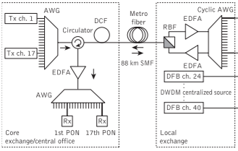
Components
It consists of the following components
Laser Transmitter
Receivers
EDFA
OADM
DWDM MUX DWDM DEMUX

Slide 15
OPTICAL FILTERS
Introduction:-
Abundance Light sources available with different wavelengths.
Limiting the range of wavelengths for applications which requires a selected region of frequency.
Thus, by the use of specialized filters, which selectively reflect, refract, diffract or absorb unwanted wavelengths and allow the remaining wavelengths to pass through the filter.
An optical filter selectively transmits one portion of the optical spectrum, while rejecting other portions.

Slide 16
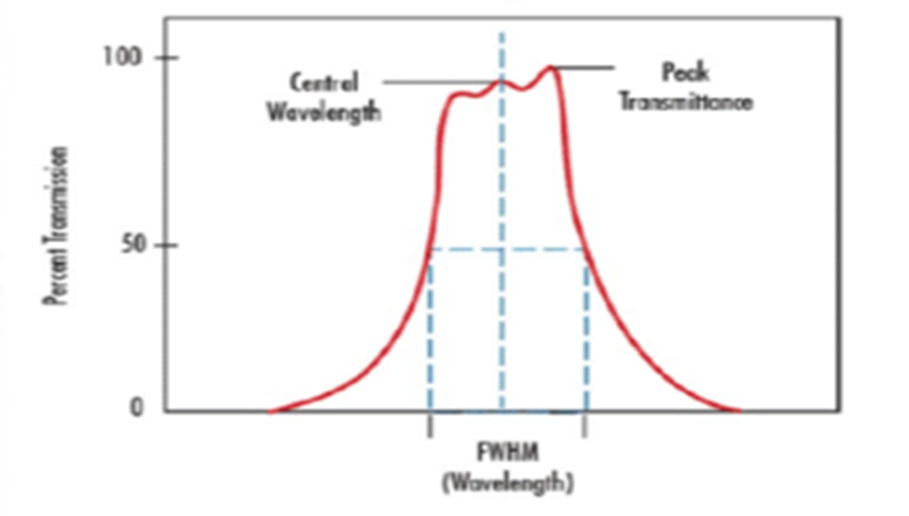
Key Optical Filter Terminology:
Center Wavelength (CWL):
It is used in defining :bandpass filters, describes the midpoint of spectral bandwidth over which the filter transmits.
Traditional Coated Optical Filters tend to achieve a maximum transmission near the center wavelength, whereas Hard Coated Optical Filters tend to have a fairly flat transmission profile over the spectral bandwidth.
Bandwidth:
Bandwidth is a wavelength range used to denote a specific part of the spectrum that passes incident energy through a filter.
Figure 1: Illustration of Center Wavelength and Full Width at Half Maximum

Slide 17
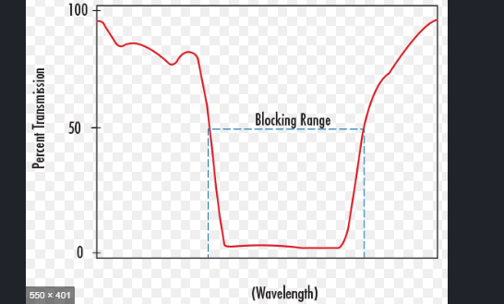
Full Width-Half Maximum (FWHM) :
It describes the spectral bandwidth over which a bandpass filter will transmit. The upper and lower limit of that bandwidth is defined at the wavelengths where the filter achieves 50% of the maximum transmission.
Blocking Range:
It is a wavelength interval used to denote a spectral region of energy that is attenuated by the filter. The degree of its blocking is typically specified in terms of optical density.
Figure 2: Illustration of Blocking Range
Slope:
It is a specification often defined on edge filters, such as shortpass or longpass filters, to describe the bandwidth over which the filter transitions from high blocking to high transmission. Given as the percent of the cut-wavelength, slope can be specified from a variety of starting and end points.

Slide 18
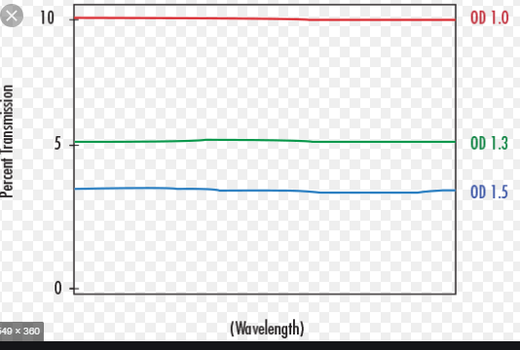
Optical Density
Optical Density (OD) describes the amount of energy blocked or rejected by a filter. A high optical density value indicates low transmission, and low optical density indicates high transmission
.
Figure 3: Illustration of Optical Density
Cut-On Wavelength
Cut-On Wavelength is a term used to denote the wavelength at which the transmission increases to 50% throughput in a longpass filter. Cut-on wavelength is indicated by λ_{cut-on}
Cut-Off Wavelength
Cut-Off Wavelength is a term used to denote the wavelength at which the transmission decreases to 50% throughput in a shortpass filter. Cut-off wavelength is indicated by λ_{cut-off}

Slide 19
TYPES OF OPTICAL FILTERS
There are two classes of optical filters that have different mechanisms of operation: absorptive filters ,dichroic filters & interference filters:
Dichroic Filters
Dichroic filters are far more capable and precise in their ability to obstruct unwanted wavelengths when compared to glass and gel absorption filters. Multi-layered thin film coatings are used for the manufacture of dichroic filters. These coatings are built up onto optical-grade glass using vacuum deposition.
Dichroic filters are widely used in a number of applications such as specific filtration for photography and optical microscopy. Dichroic filters are used instead of absorption filters for high quality color enlarges to fine tune the light color transmitted through the color transparency or negative.
Interference Filters
Interference filters differs from absorption filters. Rather than absorbing, interference filters reflect and destructively interfere with unwanted wavelength.
Modern interference filters are formed after the Fabry-Perot interferometer designed in the late 1800s by Alfred Perot and Charles Fabry. Interference filters are manufactured with a number of layers of thin films applied to a flat optically transparent glass surface.
Successive layers of dielectric materials are used to produce modern interference filters. The thickness of the dielectric materials ranges from 1/4 to 1/2 of the targeted wavelength. The dielectric materials are coated onto a flat optical glass of a polymer surface under vacuum conditions.
Light which is incident on the multi-layered dielectric surface is either passes through the filter with constructive reinforcement or reflected and decreases in magnitude by destructive interference.

Slide 20
Absorption Filters
Absorption filters work by reducing the incident light through absorption of specific wavelengths. Absorption filters are commonly made from pigmented gelatin or dyed glass. The spectral performance of an absorption filter is a function of the quantity of the dye present in the glass or gelatin matrix and the physical thickness of the filter itself.
Absorption filters are used to generate special effects in numerous photography applications and are extensively used in the cinema industry. Absorption filters are also found in traffic signals and on boats, aircrafts and vehicles as directional signals.

Slide 21
To aid in understanding the similarities and differences between the large variety of optical filters available today, consider ten of the most popular types. The following selection guide contains a brief description, as well as sample product images and performance curves for easy comparison.
Bandpass Filters Bandpass filters have extremely narrow band (<2nm to 10nm) or broadband (50nm and 80nm) transmittance across the substrate. They are particularly angle sensitive, so care should be taken when mounting and placing them within an optical setup. Hard sputtered filters should be chosen to maximize the transmission of selected wavelengths.
Long-pass Filters Long-pass filters transmit all wavelengths longer than the specified cut on wavelength. Long-pass filters include cold mirrors, color.
Short-pass Filters Short-pass filters transmit all wavelengths shorter than the specified cut off wavelength. Short-pass filters include IR cut-off filters, hot mirrors, and heat absorbing glass red glass filters, and Thermoset ADC (optical cast plastic) filters.
Heat Absorbing Glasses Heat absorbing glasses will transmit visible light and absorb infrared radiation. The absorbed energy is then dissipated as heat into the air around the glass. Forced air cooling is typically recommended to remove the excess heat. Heat absorbing glass can also be used as short-pass filters.
Cold mirrors are specific types of dichroic filters designed to have high reflectivity in the visible spectrum while maintaining high transmission in the infrared. Cold mirrors are designed for use in any application where heat build-up can cause damage or adverse effects.
Hot mirrors are specific types of dichroic filters designed to have high reflectivity in the infrared spectrum and high transmission in the visible. Hot mirrors are used primarily in projection and illumination systems.

Slide 22
Notch filters are designed to block a pre-selected bandwidth while transmitting all other wavelengths within the design range of the filter. Notch filters are used to remove a single laser wavelength, or narrow band, from an optical system.
Color substrate filters are manufactured from substrates with inherently different absorption and transmission properties across a specific spectral region. Color substrate filters are often used as longpass and bandpass filters. The boundary between transmission and blocking is less sharp compared to some coating based filters.
Neutral density (ND) filters are designed to reduce transmission evenly across a portion of a certain spectrum, ultraviolet and visible, visible, or infrared. There are two types of ND filters: absorptive and reflective. The absorptive type absorbs light that is not transmitted through the filter, while the reflective type reflects it back toward the direction from which it was incident. Special care should be taken when using the former type in order to ensure that any reflected light does not interfere with the application setup. ND filters are often used to prevent blooming or overexposure of cameras and other detectors.

Slide 23
APPLICATIONS
Photography (where some special effect filters are occasionally used as well as absorptive filters),
In many optical instruments, and to colour stage lighting. In astronomy optical filters are used to restrict light passed to the spectral band of interest, e.g., to study infrared radiation without visible light which would affect film or sensors and overwhelm the desired infrared.
Optical filters are also essential in fluorescence applications such as fluorescence microscopy and fluorescence spectroscopy

